Slide 1

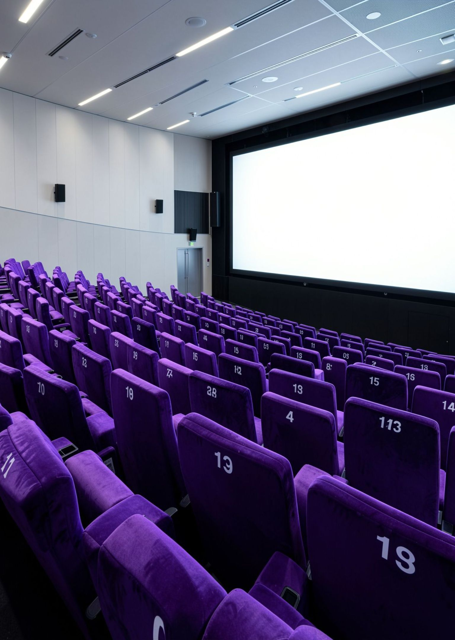
B.TECH FIRST-SEMESTER PROJECT · JAVA PROGRAMMING
CINEMA SEAT
BOOKING SYSTEM
C. Akshitha Reddy – 2620030477
C. Naga Vaishnavi – 2620030490
OBJECT-ORIENTED PROGRAMMING IN JAVA

Slide 2
PROJECT OVERVIEW
Problem Statement
Traditional cinema seat booking can involve difficulties in selecting movies, choosing show timings, and checking seat availability. Managing these steps manually may be time-consuming and can lead to confusion regarding seat selection and booking details.
Therefore, there is a need for a simple and user-friendly Cinema Seat Booking System that allows users to select a movie, choose a show timing, check seat availability, and manage booking details. This project aims to develop a Java console-based application using conditional statements, loops, arrays, searching, and counting to organize the booking process and improve its accuracy and efficiency.
Notes:
Explain the manual booking difficulties and why a simple console booking system is needed.

Slide 3
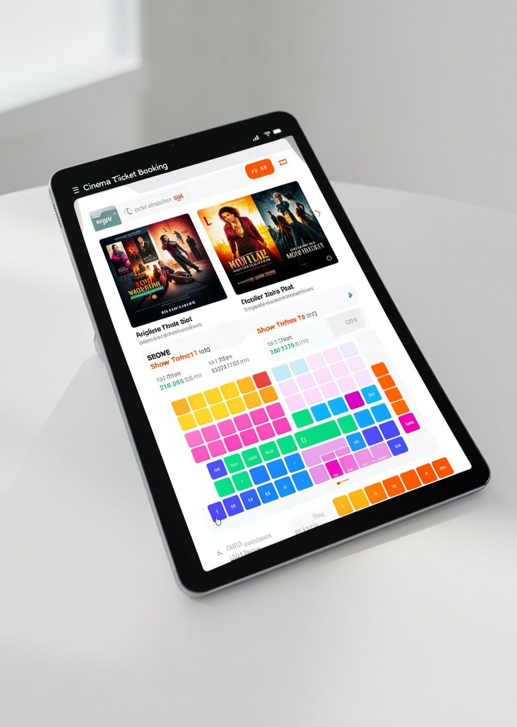

PROJECT OVERVIEW
Introduction
Our Java console program lets a user choose a movie, location, and theatre, then reserve a numbered seat. It checks availability, displays a bill, and saves confirmed bookings so those seats stay unavailable on the next run.
PROJECT SCOPE · MOVIE, VENUE, SEAT, BILL, FILE
02

Slide 4
MARKET REVIEW
Existing Applications
Existing cinema seat booking applications simplify movie ticket reservations by allowing users to choose movies, theatres, showtimes, and seats.
BookMyShow: Provides movie discovery, theatre selection, showtime selection, and online ticket booking.
District: Facilitates movie ticket bookings and provides booking confirmation.
TicketNew: Allows users to select theatres, showtimes, and seats and complete online bookings.
Common Features: Movie and theatre selection; Show timing selection; Seat selection and availability checking; Booking confirmation; Online ticket booking.
Relation to Our Project: Our Cinema Seat Booking System implements the basic booking workflow in Java using conditional statements, loops, arrays, searching, and counting. It is a simplified academic model of the core booking process, rather than a complete commercial application.
Notes:
Compare BookMyShow, District and TicketNew, then relate their common booking workflow to our Java project.

Slide 5

JAVA FOUNDATIONS
Module 1: Concepts Used in Our Project
Variables & Data Types
Constants & Literals
Menu and seat numbers use int; ticket and tax amounts use double; seat status uses boolean values.
static final values define 400 seats, the Rs. 350 ticket price, and the 5% tax rate.
Operators & Expressions
Console Input
Arithmetic calculates tax and total; comparisons and logical checks validate choices and seat availability.
Scanner reads movie, location, theatre, seat, and confirmation choices.
Formatted Output
printf displays ticket price, tax, and total with two decimal places.
03
JAVA CONSOLE BOOKING PROJECT

Slide 6
CONTROL FLOW & LOGIC
Module 2: Concepts Used in Our Project
INPUT VALIDATION
The program retries invalid entries.
Selection
if-else-if
Read the user's choice
if checks input ranges, seat availability, and whether the user confirms or cancels.
The confirmation method handles yes, no, and other responses separately.
↓
Parse text and check its range
while Loop
for & Enhanced for
↓
Menu input repeats until the user enters a valid number; confirmation repeats until yes or no.
Nested loops create the theatre grid; for loops print menus, and enhanced for counts available seats.
Valid? Continue · Invalid? Ask again
04
JAVA CONSOLE BOOKING PROJECT

Slide 7

MODULARITY & DATA STRUCTURES
Module 3: Concepts Used in Our Project
Methods & Decomposition
Parameters & Returns
Separate methods create theatres, print menus, validate input, calculate bills, and handle files.
Methods receive Scanner, arrays, or booking data and return choices, theatre objects, or booking lists.
One- and Two-Dimensional Arrays
Searching & Counting
String arrays store movies and locations; String[][] stores theatres; boolean[400] stores seat status.
isSeatAvailable checks a seat index; getAvailableSeatCount traverses the array and counts free seats.
05
JAVA CONSOLE BOOKING PROJECT

Slide 8
OBJECT-ORIENTED DESIGN & ERRORS
Module 4: Concepts Used in Our Project
OBJECT MODEL
Each venue owns its seat array.
Classes & Objects
Encapsulation
Theatre
location · name · boolean[400]
Theatre models a venue and its seats; Booking represents one confirmed movie and seat.
Private fields protect seat and booking data; public methods provide controlled access.
↓
Constructors & Constants
Interface & Overriding
Booking
movie · theatre · seat · price
Constructors initialize each theatre and booking; static final values hold shared settings.
Booking implements Billable and defines calculateTotal; Theatre overrides toString for display.
↓
implements Billable
calculateTotal()
Exception Handling
NumberFormatException handles invalid numbers; IllegalArgumentException guards seats; IOException handles file errors.
06
JAVA CONSOLE BOOKING PROJECT

Slide 9
STRINGS, LIBRARIES & FILES
Module 5: Concepts Used in Our Project
BOOKING PERSISTENCE
A text file restores seat status.
String Processing
String Immutability
trim removes extra spaces; equalsIgnoreCase checks yes/no; split reads saved comma-separated records.
String operations return text values; the program stores the trimmed or split results for use.
Startup: readAllLines()
↓
Restore previously booked seats
File Input
File Output
Files.readAllLines loads saved bookings when the program starts.
Files.writeString appends each confirmed booking using CREATE and APPEND options.
↓
Confirmation: writeString(APPEND)
Library Types
Path identifies the file; System.lineSeparator adds a platform-appropriate line break.
07
JAVA CONSOLE BOOKING PROJECT

Slide 10
PROJECT CONCLUSION
Conclusion
The Cinema Seat Booking System demonstrates how Java programming concepts can be used to simplify and organize the movie ticket booking process. The system allows users to select movies, choose show timings, check seat availability, and manage booking details through a console-based interface. By applying variables, conditional statements, loops, arrays, searching, and counting, the project provides a structured approach to seat management and booking operations. This project strengthens our understanding of Java fundamentals and their practical applications in real-world scenarios.
Future Scope: The system can be enhanced by adding a graphical user interface, database connectivity, online payment facilities, and real-time seat availability updates.
Notes:
Summarise what the Java console booking system achieves and point to future enhancements.

Slide 11

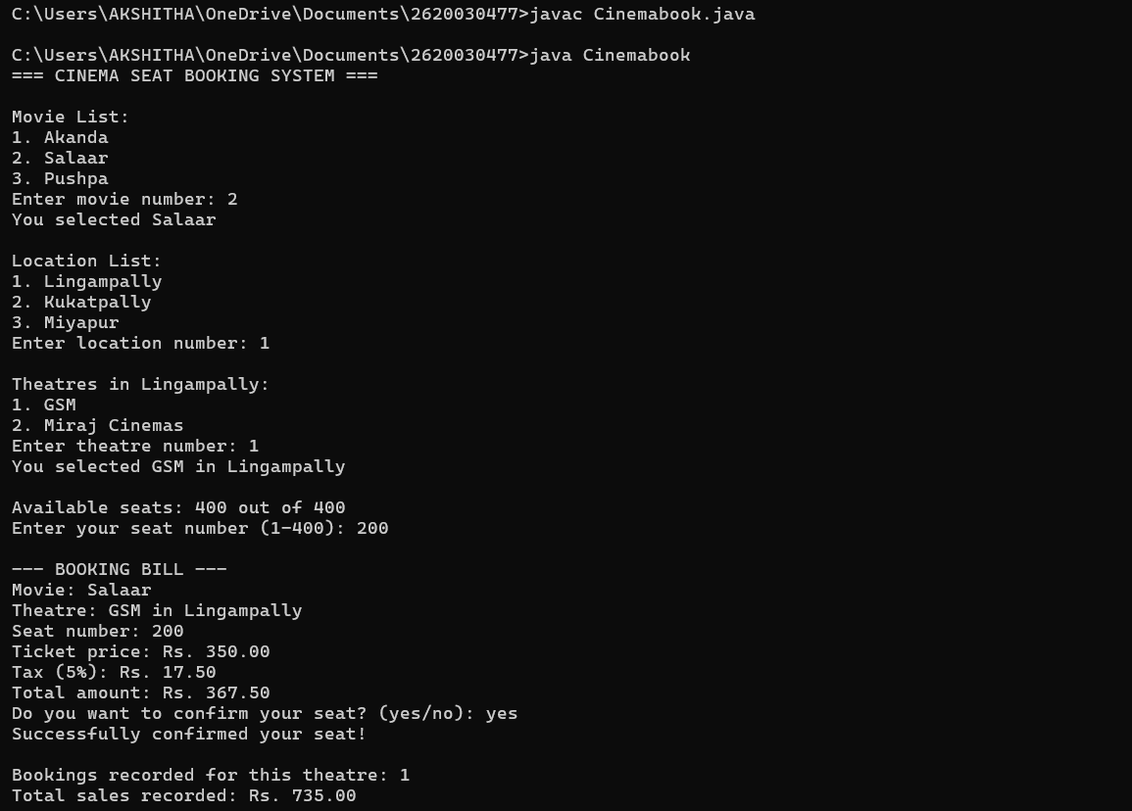
PROJECT DEMONSTRATION
Sample Output
EXAMPLE RUN · STARTS WITH NO SAVED BOOKINGS
09

Slide 12
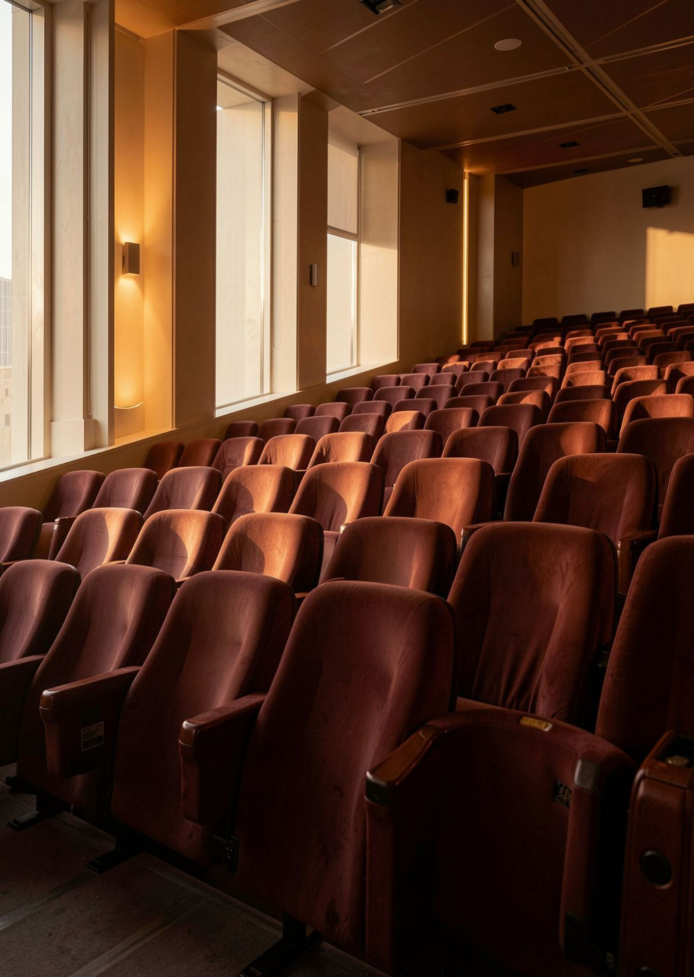

PROJECT PRESENTATION CONCLUDED
THANK YOU
PRESENTED BY
C. Akshitha Reddy – 2620030477
C. Naga Vaishnavi – 2620030490
CINEMA SEAT BOOKING SYSTEM · JAVA CONSOLE APPLICATION

